Slide 1
Training And Testing Of Network (object detection)
Presented by:
Prashant Sharma 170110001
Riya Sharma 170110002

Slide 2

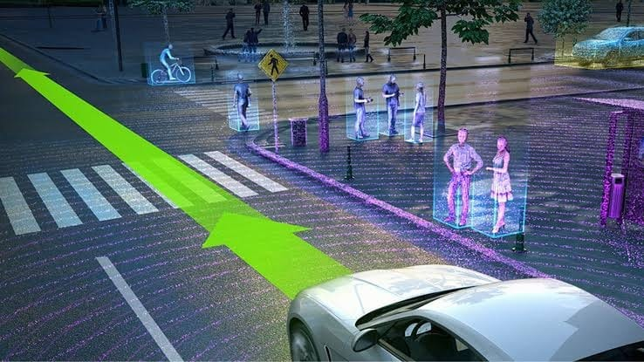
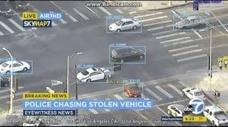


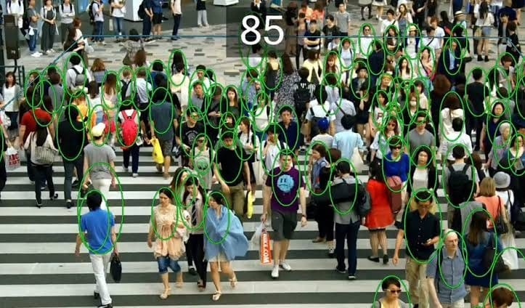

User Cases
Autonomous Car
Video survillance...eg police chasing stolen vehicle
Crowd counting or people counting

Slide 3




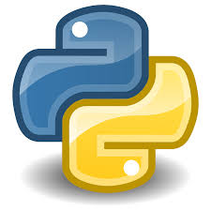
Using
Google Colab
Python modules and libraries
Object detection module: Faster RCNN + InceptionResNet V2
Tensorflow
Tensor Hub

Slide 4
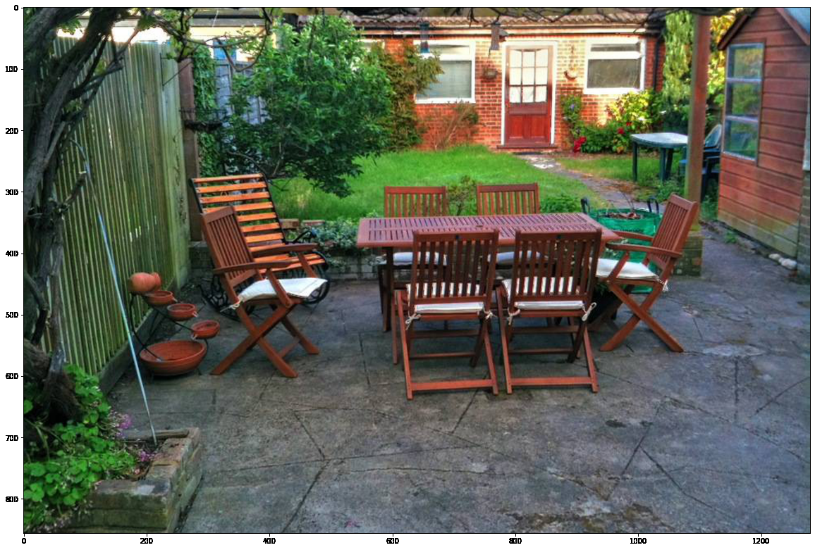
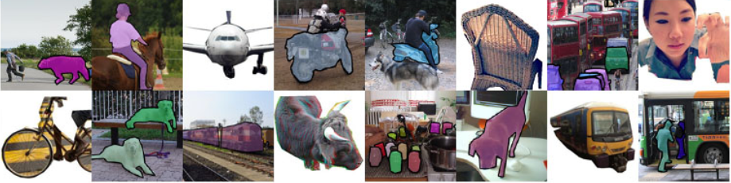
Images
The images are taken from internet.
The url is provided of the image on which detection procedure is done.
Images example:

Slide 5
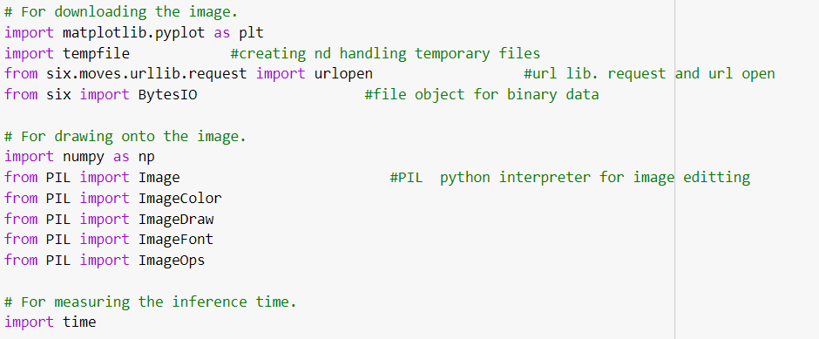
Pyhton Modules

Slide 6
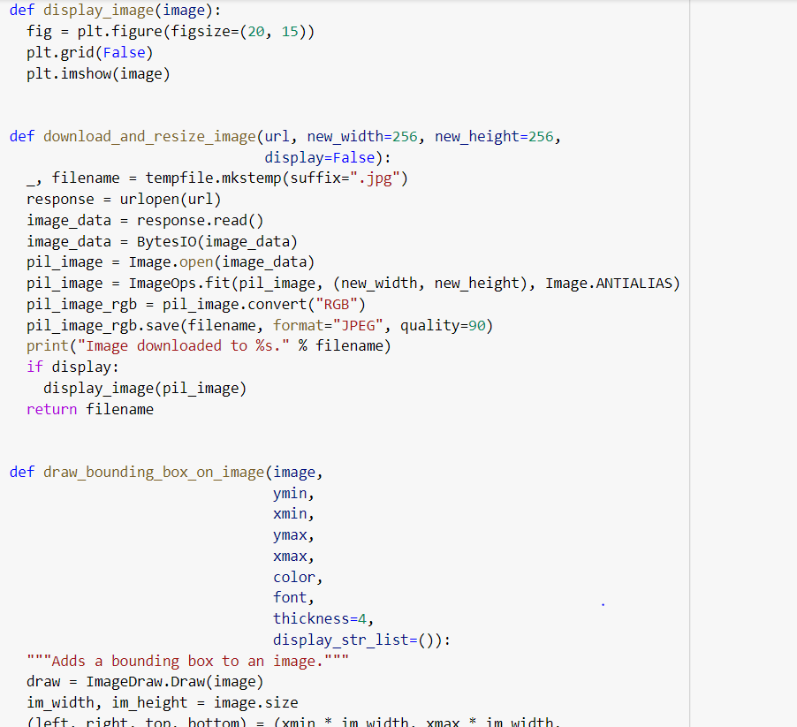
Preprocessing the image

Slide 7
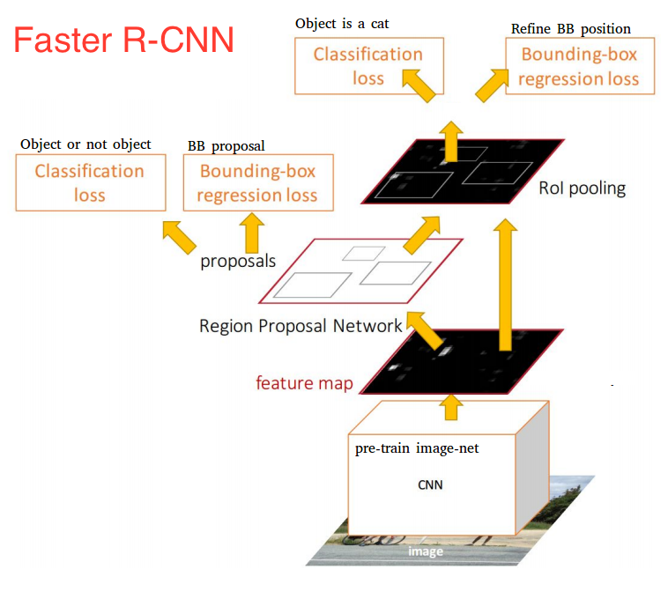
Object Detection
Faster RCNN + InceptionResNet V2
Faster R-CNN is now a canonical model for deep learning-based object detection. It helped inspire many detection and segmentation models that came after it.
Using the Faster R-CNN Inception Resnet v2 model pre-trained on COCO to train my own object detector with the purpose of detecting objects

Slide 8
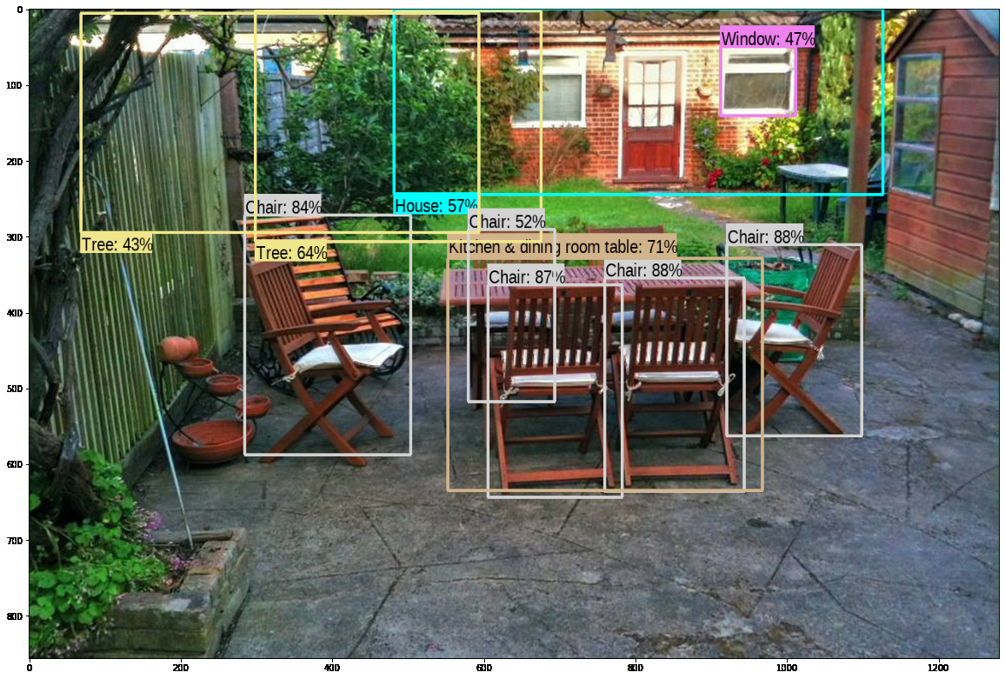
Detection in Image

Slide 9
THANK YOU
BY: Prashant Sharma 170110001
Riya Sharma 170110002

